Slide 1
REAL ESTATE SERVICE USING BLOCKCHAIN

Slide 2
Presented by,
Avishek Roy
1807053
Abu Taher Md. Shifat
1807015
Computer Science and Engineering
Supervised by,
Dr. Kazi Md. Rokibul Alam
Professor
Department of Computer Science and Engineering,
Khulna University of Engineering & Technology, Khulna

Slide 3
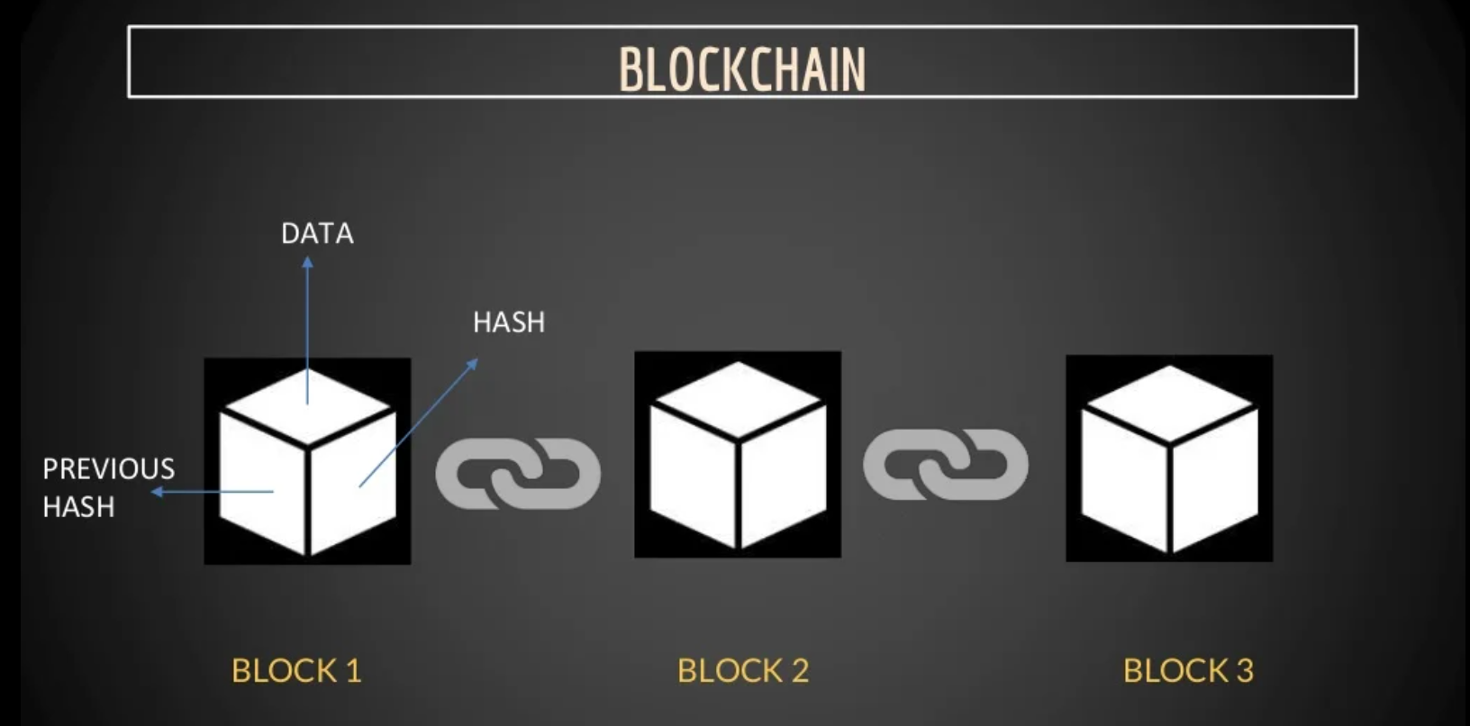
~Advanced database mechanism. ~Transparent information sharing. ~Stores data in blocks that are linked together in a chain.
What is Blockchain?

Slide 4
Features of Blockchain:
~Decentralization & Distributed System
~Immutability
(trust-worthy source)
~Direct Transaction
(No middle-man necessary)

Slide 5
key components of blockchain technology:
- Smart contracts
- Public key cryptography

Slide 6
Challenges of using Blockchain:
No middle-man
( Whom to ask if something goes wrong? )

Slide 7
Any person can buy or sell their real estate property without the help of a third party.
Our system:
Real Estate Service using Blockchain

Slide 8
Blockchain in Real Estate:
Database
Owner
Accountant
Payment
Reduce Effort
Increase Transparency

Slide 9
Benefits of using blockchain in real estate system:
Impact of our System
Transperacy
Eleminating Frauds
Improved Operation
More Secure

Slide 10
New to our country, but not new to the world
Case Georgia:
Back in 2019, the government of Georgia started using blockchain to register lands and validate property

Slide 11
Ethereum Blockchain
This blockchain supports developers to write smart contract

Slide 12
What is Smart Contract?
~Smart Contract is a piece of code that interacts with the blockchain
~Written in solidity

Slide 13
What is solidity?
~Solidity is a object oriented programming language to create smart contract.

Slide 14
Private key:
Used for signing a transaction
Public key: Used for verifying a transaction

Slide 15
Metamask:
~a cryptocurrency wallet compatible with Ethereum blockchain
~holds public key and private key of an account

Slide 16
Hardhat
~A development environment for smart contracts
~Facilitates testing of the contracts on local machine

Slide 17
IPFS:
Decentralized network of nodes that stores data in a distributed manner

Slide 18
Testnet ~Demo blockchain used deploying smart contracts for development purposes ~Goerli

Slide 19
Flow chart of the project
Connect to the smart Contract using meta mask
Ipfs file meta data
Creation of NFT mapped to real estate
NFT creation function
User
Cancel Listed property
List the property For Sale
Buy Listed property

Slide 20
No third party is involved ~Sale and buying of properties can in fact occur in a decentralized manner

Slide 21
Limitations ~Yet to verify the existence of the property in real life in a decentralized manner.

Slide 22
THANK YOU

